Slide 1
Math analysis
Day 27

Slide 2
Objective
Create a replica of a “Real Life” image that isn’t already pixelated.

Slide 3
Saving Your Image:
In Bricklayer Lite Level 3
Save your object as Name_Real_Image.xml
To Turn In Folder: 12_Real_Image_Formative
Save to One Drive and/or Flashdrive!!!

Slide 4





Schools

Slide 5





Sports

Slide 6







Brands

Slide 7
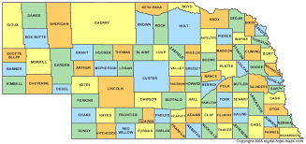
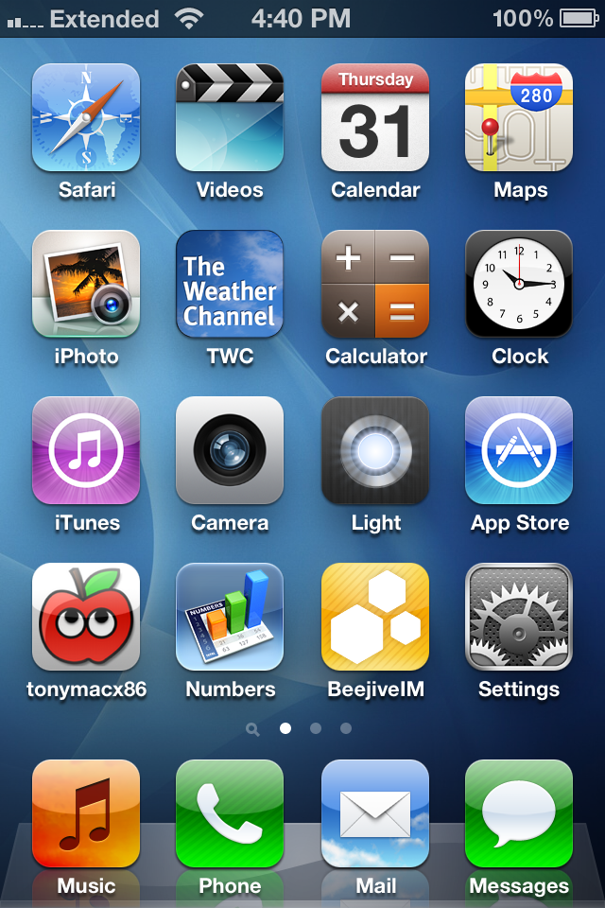


Other Interests

Slide 8
Review Saving in Bricklayer Lite to Teams
Change “Filename” make sure it ends with .xml
Click Download XML
Open up Teams
Open the appropriate folder: ______________________
Click “upload” and select your recently downloaded file
Save
*Move the file to your One Drive from your Downloads folder

